Slide 1
Object Oriented Programing
Presented by Yasir Nawaz

Slide 2

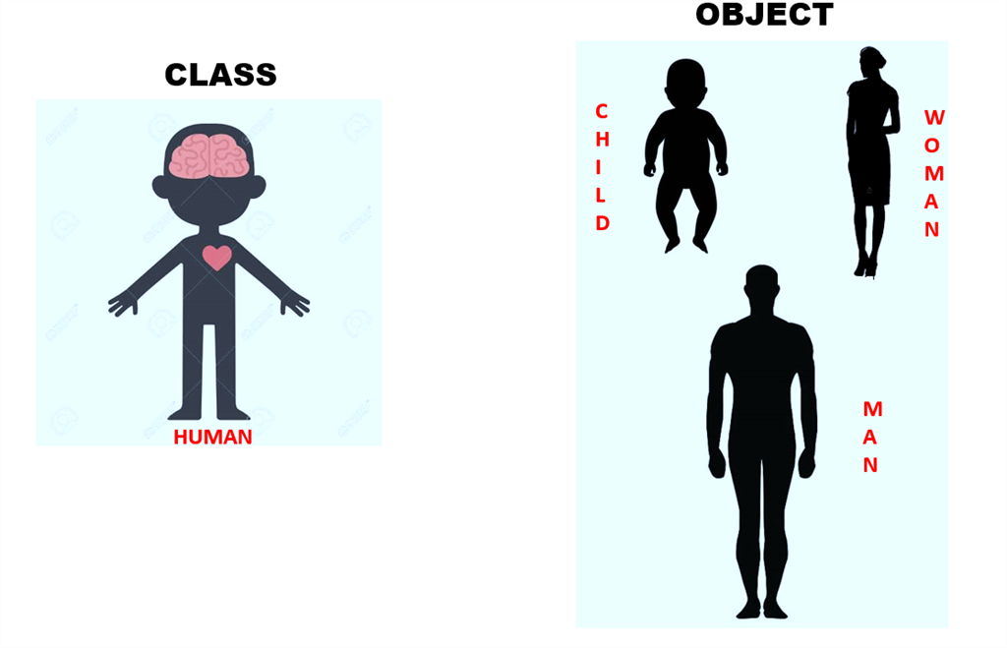
Object Oriented Programming
What is Object Oriented Programming?
“Object Oriented Programing is the way of programing, based on hierarchy of classes with cooperating objects”
What is a Class?
A Class is a structure that defines the data and methods working on that data.
What is an Object?
Objects are the instances of a class created with specifically defined data.
Objects
Class
Child
women
Human
Men

Slide 3
Classes as data types …
Every computer language comes with a verity of built in data types.
Most of the popular programming languages provides the way of building your own data types.
Classes could be programmer defined data types
And java is one of them.
Object oriented programming is a way of programming that is dominated to create a new data type.

Slide 4
How to design a class
Requirements:
Find out the problem to be solved.
What are the specifications required.
Classes could be nouns.
And verbs are the behavior and methods (which also defines class’s responsibilities).
Look around in scenarios to find nouns and verbs.
Implementation and testing of classes.
Designing may normally be the hardest part.
Planning to reuse.

Slide 5



Class design …
Classes should be cohesive.
A class should be designed in a way to do one thing correctly.
Classes should not be tightly coupled.
Any changes in the implementation of a class should not affect other classes.
Loose coupling can also be achieved with in a class itself.

Slide 6
The Pillars of the Paradigm
Encapsulation
Encapsulation include bundling of data and methods that operates on that data in single unit.
Inheritance
Inheritance serves as the powerful method for reusing code.
Polymorphism
A concept of allowing objects to work in different forms and behaviors.
Abstraction
It handles complexity of a code by hiding unnecessary details or implementations.

Slide 7

Encapsulation
A language mechanism for restricting direct access to some of an object’s components
There are some modifiers that defines the accessibility of classes
Private: declares members of a class are accessible within the class.
Public: this modifier has the widest scope as classes and methods that are public can be accessed from anywhere in your code.
Getters and Setters are methods for accessing and updating private variables in a class.
Class
Variables
Encapsulation
Methods

Slide 8
Access Modifiers …
Modifiers | Class | Package | Subclass | Other classes
Default | Yes | Yes | No | No
Private | Yes | No | No | No
Protected | Yes | Yes | Yes | No
Public | Yes | Yes | Yes | Yes

Slide 9
Inheritance
Inheritance is a parent and a child relationship between classes.
Every class could be derived from one other class and that class is called as parent or super class.
The derived class is called as a subclass or a child class.
It includes all the properties and behaviors of the parent class in a child class.
Along with the properties and methods of a superclass, a child class can also have its own properties and methods.
Overriding can also be done while re-writing methods from the parent class.

Slide 10





Inheritance …
MEN
DOCTOR
ENGINEER
CRICKETER
DEVELOPER

Slide 11
Polymorphism
The word polymorphism is derived from Greek words.
Poly: Many and Morphism: Forms
Polymorphism describes the situation where a single interface is used in multiple forms.
It increases the ability to reuse the same line of code on different occasions.
Polymorphism allows single variable name to be used for storing values of different data types such as int, long, float and double.
Polymorphism
Shapes

Slide 12
Types of Polymorphism
There are mainly Two types of polymorphism:
Compile Time Polymorphism
Run time polymorphism
Compile Time (Overloading)
It accurse during the compiling process.
Method overloading is achieved when we use same methods with different parameters or types.
Run Time (Overriding)
Method overriding is used to implement a method that is already defined in the parent or super class.
Runtime polymorphism in oop is also known as dynamic binding or late binding.
Polymorphism
Compile time (Static Polymorphism)
Run time (Dynamic Polymorphism)

Slide 13
Abstraction
Using abstraction principle, a programmer hides all the internal details about an object.
It is used to build a boundary wall between the application and client program.
It is easier to manage and update the code.
Its flexible for adopting new requirements or changes.
We can say abstraction simplifies the process of software development by focusing on “what” rather than “how”.
Abstraction is a design-level process, but encapsulation is an implementation process.

Slide 14
Types of abstraction
There are manly two types of abstraction:
Data abstraction:
When the objects data is not visible to outer world
Object
User Program
Private
Name: String
Id: Int
Public
Accessibility
get_name()
set_name(str)
Public
get_id()
set_id(str)

Slide 15
Types of abstraction …
Process abstraction:
When we do not need to provide the implementation process.
It hides the internal implementation of functions involved in a user Operation
Object
Private
User Program
fill_fuel()
ignition()
Move_bracks()
change_speed()
Accessibility
Public
turn_on()
turn_off()
accelerate()
brake()
change_gear()

Slide 16


